Slide 1
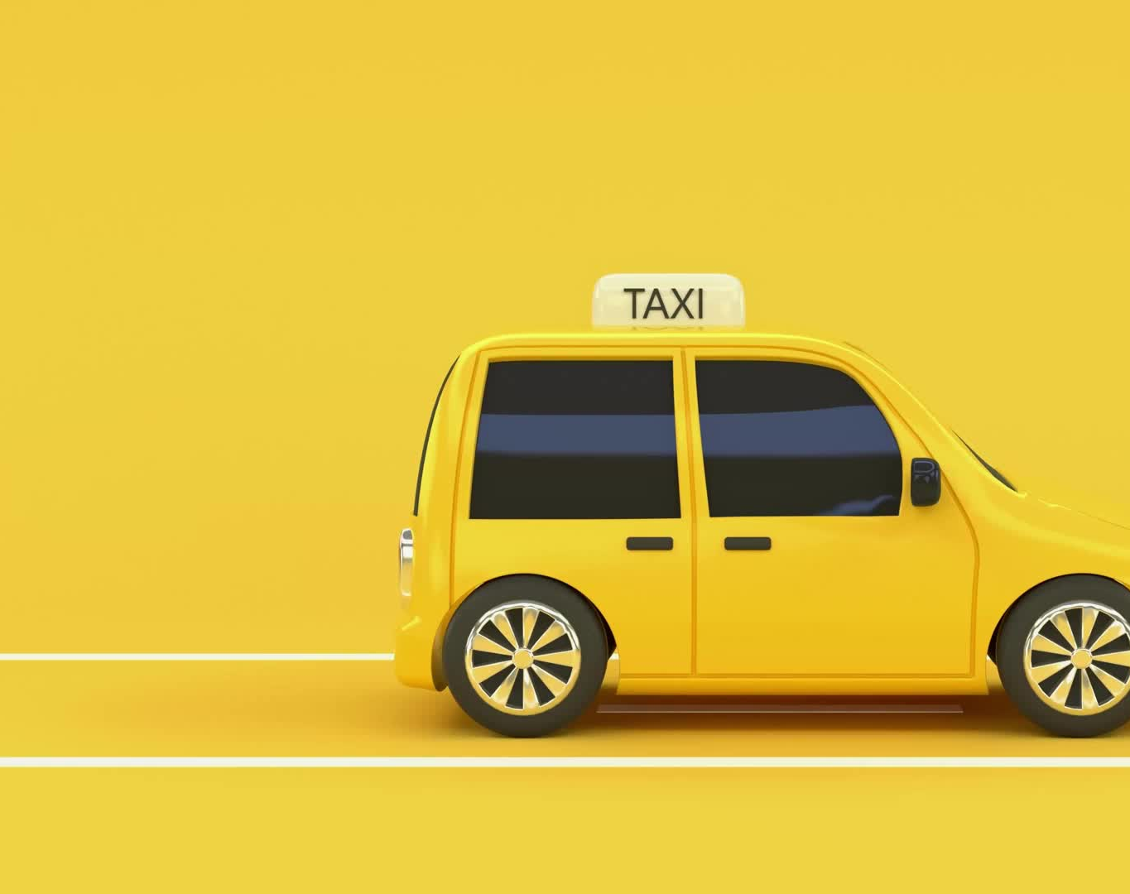
Taxi Trip Duration Analysis

Slide 2
Group Member Information
Kishor Kumar Andekar kxa47130@ucmo.edu
Sai Preetham Nagaswaram sxn33500@ucmo.edu
Pondugula Niteesh Kumar nxp32580@ucmo.edu
Rohith Reddy Pinninti rxp93930@ucmo.edu

Slide 3
Roles, Responsibilities and Contributions
Kishor Kumar Andekar:
Data collection and preprocessing
Exploratory data analysis
Model development and training
Sai Preetham Nagaswaram:
Literature review and related work
Feature engineering and selection
Model evaluation and validation
Pondugula Niteesh Kumar:
Problem formulation and motivation
Design of the deep learning architecture
Integration of advanced techniques (Dropout, BatchNormalization)
Rohith Reddy Pinninti:
Visualization of results and insights
Comparative analysis with baseline models
Documentation and presentation

Slide 4

Motivation
Accurate taxi trip duration prediction is crucial for:
Optimizing taxi operations and dispatch systems
Enhancing passenger satisfaction with reliable estimates
Supporting urban planning and traffic management decisions
Existing models struggle with the complexity and dynamicity of urban environments
Deep learning offers a promising approach to capture intricate patterns and dependencies in taxi trip data

Slide 5
Objectives
Develop a deep learning model to accurately predict taxi trip durations in urban settings
Incorporate advanced techniques like Dropout, BatchNormalization, and the Adam Optimizer to improve model performance and generalization
Utilize comprehensive taxi trip data, including spatiotemporal features, to capture the complex dynamics of urban transportation
Provide insights to support operational efficiency, service quality, and urban planning

Slide 6
Related Work
Statistical models and basic machine learning approaches have been used for taxi trip duration prediction [1]
Deep learning models, such as LSTMs and CNNs, have shown promise in capturing temporal and spatial dependencies [2][3][23]
Integration of real-time data, such as traffic conditions and weather, has improved prediction accuracy [12][18]
Graph Convolutional Networks (GCNs) have been employed to model road network topology and predict taxi demand [10][16]
Multitask learning approaches have been explored to leverage the relationships between related prediction tasks [9][17]

Slide 7

Problem Statement
Predicting taxi trip durations in urban environments is challenging due to:
Dynamic traffic conditions influenced by time, weather, events, and incidents
Complex spatial dependencies and urban infrastructure
High dimensionality and heterogeneity of relevant data sources
Existing models often struggle to capture these complexities and adapt to changing conditions, leading to suboptimal predictions and operational inefficiencies

Slide 8
Proposed Solution
Develop
Develop a deep learning model based on Sequential Neural Networks and Dense Layers
Preprocess the data by cleaning, transforming, and engineering relevant features
Temporal features: time of day, day of week, holiday indicators
Spatial features: pickup and dropoff locations, Haversine distances
Contextual features: passenger count, weather conditions
Incorporate
Incorporate advanced techniques to improve model performance and generalization
Dropout regularization to prevent overfitting
BatchNormalization for faster and more stable training
Adam Optimizer for efficient optimization and convergence
Employ
Employ a robust training and validation strategy
Split the data into training, validation, and testing sets
Use EarlyStopping and ModelCheckpoints to prevent overfitting and save the best model
Perform hyperparameter tuning using techniques like grid search and random search

Slide 9
Results/Simulations
Conducted extensive data analysis and visualization
Geospatial analysis of pickup and dropoff locations
Distribution of trip distances, durations, and fares
Relationship between passenger count and trip characteristics
Evaluated the model using various performance metrics
Mean Squared Error (MSE) and Root Mean Squared Error (RMSE)
Mean Absolute Error (MAE) and R-squared (R²) score
Cross-validation techniques to assess model robustness
Compared the proposed model with baseline models
Linear Regression, Decision Trees, and Ensemble methods
Demonstrated superior performance of the deep learning approach
Achieved promising results on the validation set
MSE: 138385.4677
RMSE: 372.002 (in seconds)
Identified areas for further improvement and refinement
Incorporation of additional data sources and real-time information
Exploration of more advanced architectures and techniques

Slide 10
References
[1] N. R K, J. K, A. Joseph, K. Sakthivel, and S. S. Anandharajan, "New York City Taxi Trip Duration Prediction Using Machine Learning," International Journal for Research in Applied Science & Engineering Technology, vol. 11, 2023, doi: 10.22214/ijraset.2023.52768.
[2] S. Al-Shoukry, B. J. M. Jawad, Z. B. Musa, and A. H. Sabry, "Development of predictive modeling and deep learning classification of taxi trip tolls," Eastern-European Journal of Enterprise Technologies, 2022. Available: https://pdfs.semanticscholar.org/23be/a2ccf6be7cfdf4c7a70a62e3675b22209e38.pdf
[3] C. Zhang, F. Zhu, Y. Lv, P. Ye and F. -Y. Wang, "MLRNN: Taxi Demand Prediction Based on Multi-Level Deep Learning and Regional Heterogeneity Analysis," IEEE Transactions on Intelligent Transportation Systems, vol. 23, no. 7, pp. 8412-8422, July 2022, doi: 10.1109/TITS.2021.3080511.
[4] X. Xue, C. Zhou, X. Zhang, and J. Guo, "A taxi demand prediction model based on spectral domain graph convolution," Journal of Applied Remote Sensing, vol. 12613, pp. 1261319-1261319-6, 2023, doi: 10.1117/12.2673584.
[5] Y. Cheng et al., "Block Popularity Prediction for Multimedia Storage Systems Using Spatial-Temporal-Sequential Neural Networks," Proceedings of the 29th ACM International Conference on Multimedia (MM '21), pp. 3390–3398, 2021, doi: 10.1145/3474085.3475495.
[6] U. Sahin, "A Deep Learning Approach to Forecasting Short-Term Taxi Demands," 2022 30th Signal Processing and Communications Applications Conference (SIU), pp. 1-4, 2022, doi: 10.1109/SIU55565.2022.9864773.
[7] X. Zhang, Z. Zhao, Y. Zheng, and J. Li, "Prediction of Taxi Destinations Using a Novel Data Embedding Method and Ensemble Learning," IEEE Transactions on Intelligent Transportation Systems, vol. 21, pp. 68-78, 2020, doi: 10.1109/TITS.2018.2888587.
[8] F. Mao, Z. Li, and K. Zhang, "DeepCorNet: A efficient taxi-hailing prediction model," Journal of Physics: Conference Series, vol. 1693, 2020, doi: 10.1088/1742-6596/1693/1/012083.
[9] R. Jegadeesan et al., "Forecasting of origin-to-destination requests for taxis using DNN algorithm with NYU database," AIP Conference Proceedings, 2023, doi: 10.1063/5.0150597.
[10] Z. Chen, B. Zhao, Y. Wang, Z. Duan, and X. Zhao, "Multitask Learning and GCN-Based Taxi Demand Prediction for a Traffic Road Network," Sensors, vol. 20, no. 13, 3776, 2020, doi: 10.3390/s20133776.
[11] E. Hassanzadeh and Z. Amini, "Using Neural Network for Predicting Hourly Origin-Destination Matrices from Trip Data and Environmental Information," Scientia Iranica, 2023, doi: 10.24200/sci.2023.58193.5608.
[12] Y. He, M. Hu, L. Yuan, and H. Jiang, "Flight taxi-out time prediction based on deep learning," Proc. SPIE 12081, MIPPR 2021: Pattern Recognition and Computer Vision, 1208127, 2022, doi: 10.1117/12.2623856.
[13] K. Zhao, D. Khryashchev, and H. Vo, "Predicting Taxi and Uber Demand in Cities: Approaching the Limit of Predictability," IEEE Transactions on Knowledge and Data Engineering, vol. 33, no. 7, pp. 2723-2736, 2021, doi: 10.1109/TKDE.2019.2955686.
[14] Y. Li, S. Cui, L. Zhang, B. Liu, and D. Song, "Taxi Destination Prediction with Deep Spatial-Temporal Features," 2021 International Conference on Communications, Information System and Computer Engineering (CISCE), pp. 562-565, 2021, doi: 10.1109/CISCE52179.2021.9445931.
[15] J. Tang, J. Liang, T. Yu, Y. Xiong, and G. Zeng, "Trip destination prediction based on a deep integration network by fusing multiple features from taxi trajectories," IET Intelligent Transport Systems, 2021, doi: 10.1049/ITR2.12075.
[16] D. Cao et al., "BERT-Based Deep Spatial-Temporal Network for Taxi Demand Prediction," IEEE Transactions on Intelligent Transportation Systems, vol. 23, no. 7, pp. 9442-9454, 2022, doi: 10.1109/tits.2021.3122114.
[17] H. Luo, J. Cai, K. Zhang, R. Xie, and L. Zheng, "A multi-task deep learning model for short-term taxi demand forecasting considering spatiotemporal dependences," Journal of Traffic and Transportation Engineering, 2020, doi: 10.1016/j.jtte.2019.07.002.
[18] J. Zhao, C. Chen, H. Huang, and C. Xiang, "Unifying Uber and taxi data via deep models for taxi passenger demand prediction," Personal and Ubiquitous Computing, pp. 1-13, 2020, doi: 10.1007/s00779-020-01426-y.
[19] S. Sonbhadra, S. Agarwal, M. Syafrullah, and K. Adiyarta, "An Application of Ensemble and Deep Learning Models in Predictive Analytics," 2020 IEEE 7th International Conference on Industrial Engineering and Applications (ICIEA), pp. 574-582, 2020, doi: 10.1109/ICIEA49774.2020.9102115.
[20] Z. Chen, "Multi-Source Information Based Short-term Taxi Demand Prediction Using Deep-Learning Approaches," Journal of Physics: Conference Series, vol. 2033, no. 1, 012167, 2021, doi: 10.1088/1742-6596/2033/1/012167.
[21] J. Du, M. Hu, W. Zhang, and J. Yin, "Finding Similar Historical Scenarios for Better Understanding Aircraft Taxi Time: A Deep Metric Learning Approach," IEEE Intelligent Transportation Systems Magazine, vol. 15, no. 2, pp. 101-116, 2023, doi: 10.1109/MITS.2021.3136329.
[22] H. Huang, "Taxi fare prediction based on multiple machine learning models," Applied and Computational Engineering, 2023, doi: 10.54254/2755-2721/16/20230849.
[23] C. Hsu and H. Chen, "Taxi Demand Prediction based on LSTM with Residuals and Multi-head Attention," Science and Information Conference, pp. 268-275, 2020, doi: 10.5220/0009562002680275.

